Slide 1
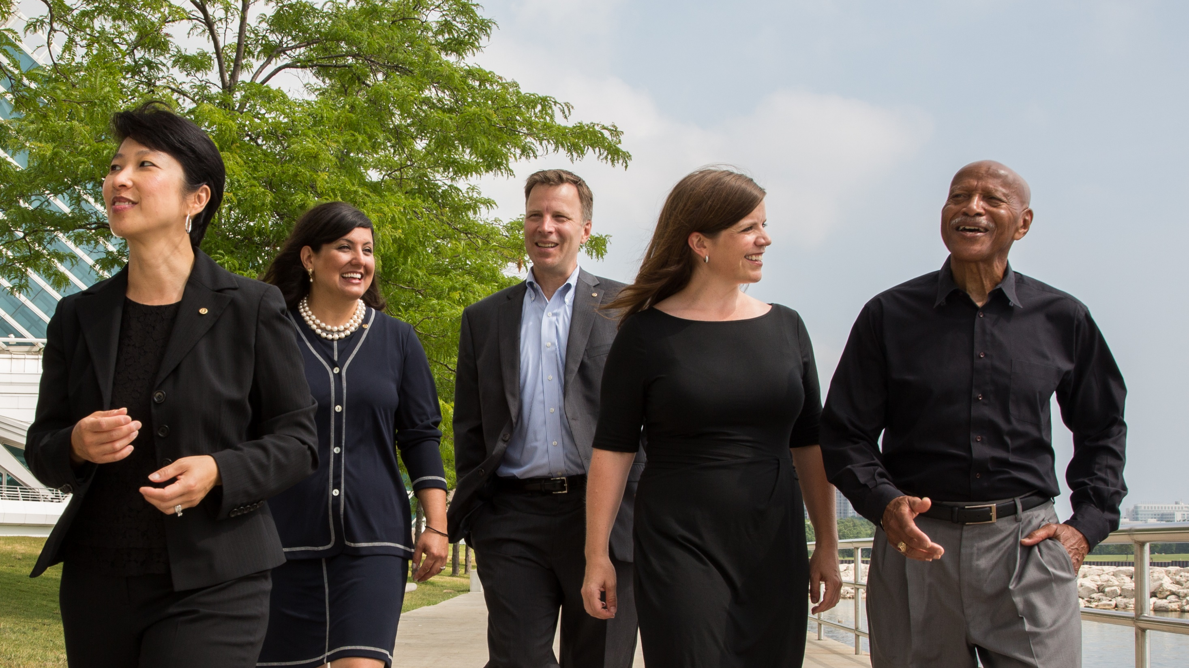
What we value
Integrity, diversity, service, leadership, and fellowship
ROTARY.ORG/DEI
Notes:
Rotary was founded on principles that remain at the heart of the organization today. These principles reflect our core values — integrity, diversity, service, leadership, and fellowship, or friendship. Our core values emerge as themes in our guiding principles.
Important to note is that Rotary is apolitical and nonreligious, and does not discriminate on the basis of gender, race, color, faith, national origin, or sexual orientation.
Each club strives to reflect the diversity of its community by including members from a mix of professions, genders, ages, and ethnicities. Having members with different backgrounds and viewpoints gives each club a broader understanding of the community and its problems, and better equips it to find solutions.

Slide 2
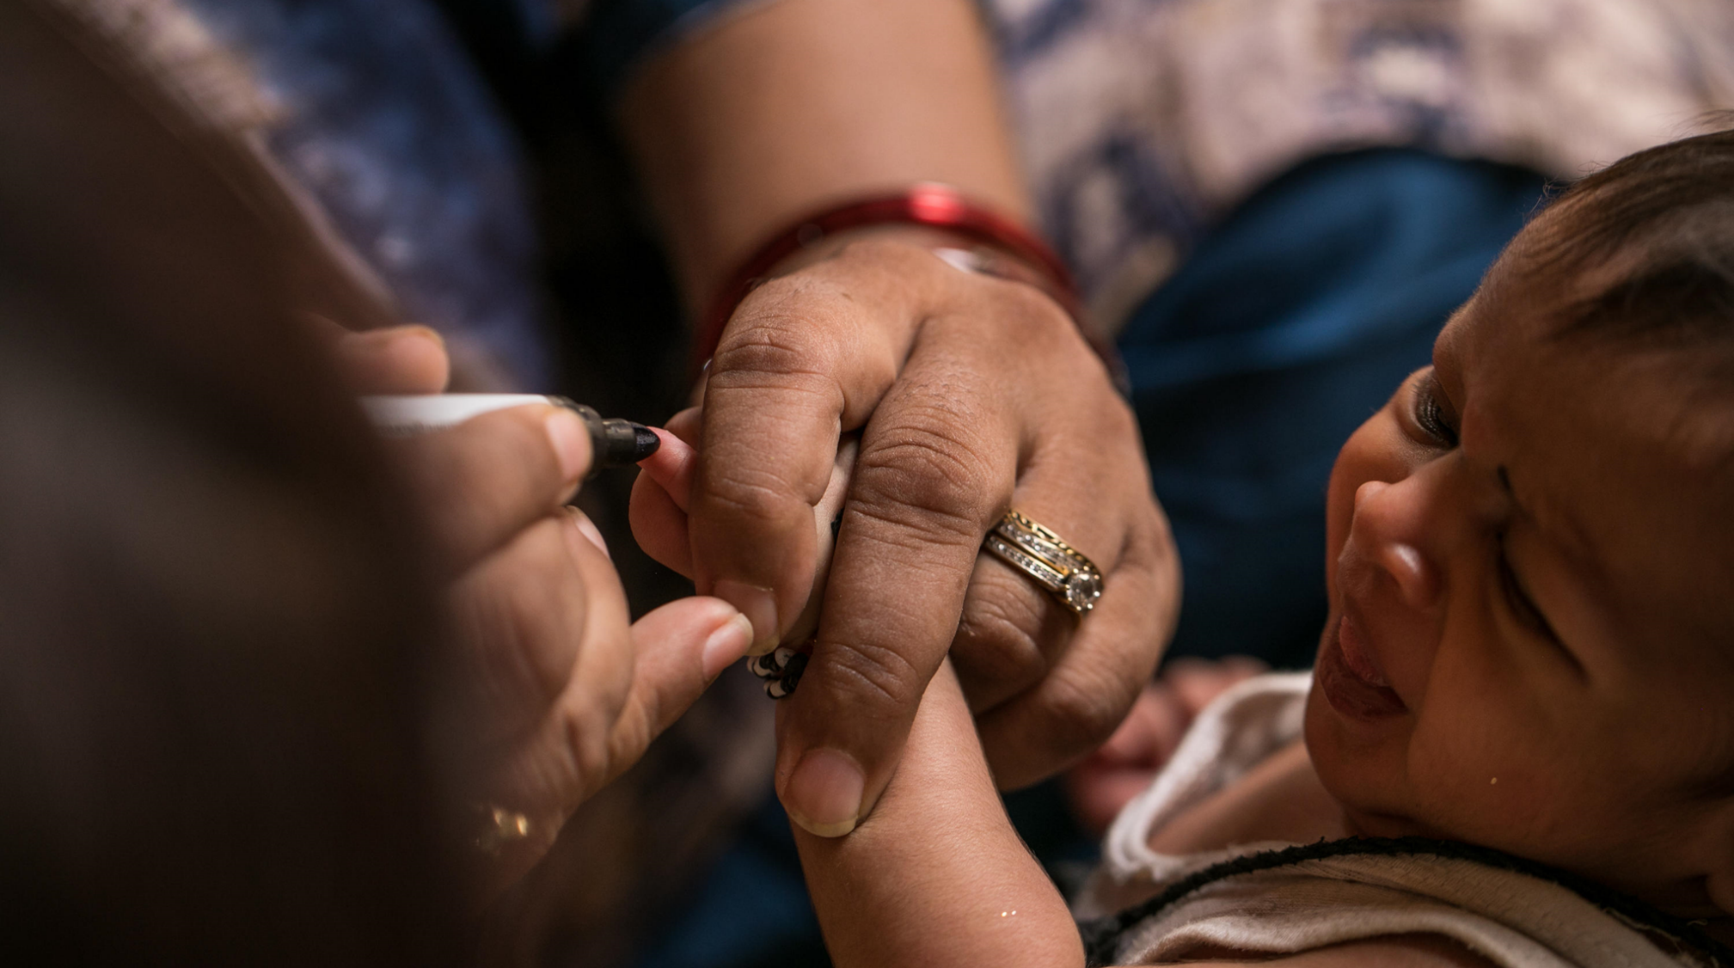
subhead
Our causes
Support the environment
Promote peace
Fight disease
Provide clean water, sanitation, and hygiene
Save mothers and children
Support education
Grow local economies
Notes:
The collective leadership and expertise of our 1.2 million members helps us tackle some of the world’s biggest challenges, locally and globally. We are united by common values and vision for the future as we sharpen our focus with targeted specific causes that will reach communities most in need.
Rotary members believe that we have a shared responsibility to take action on our world’s most persistent issues. Our 36,000+ clubs work together to:
Support the environment
Promote peace
Fight disease
Provide clean water, sanitation, and hygiene
Save mothers and children
Support education
Grow local economies

Slide 3
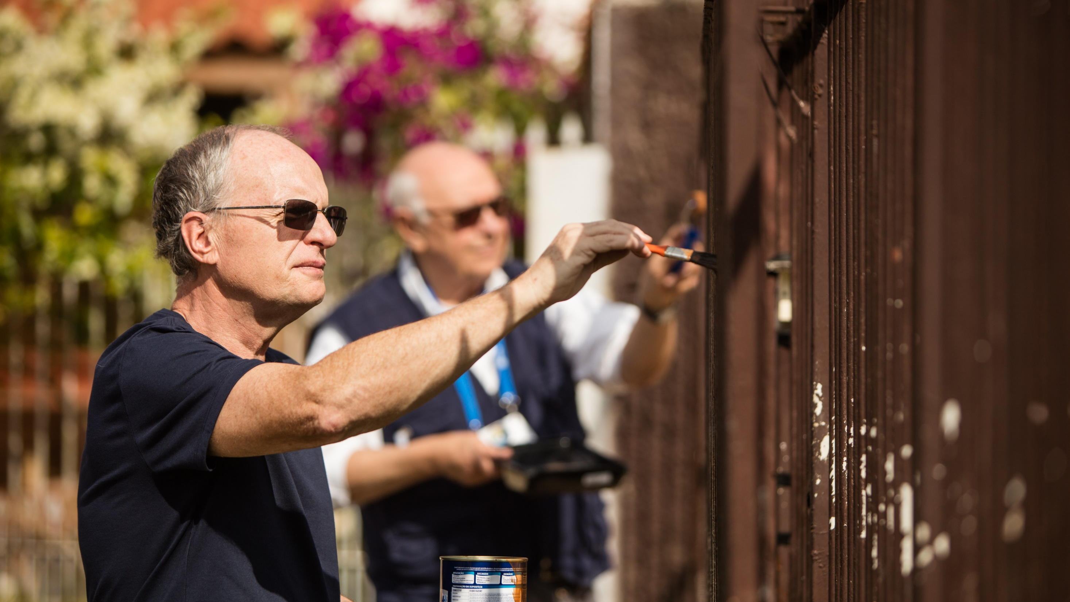
“service above self”
With help from experts and mentors in the district resource network, members design projects and grants that will have lasting benefits for the community.
ROTARY.ORG/TAKE-ACTION
Notes:
And even though members have been making a meaningful difference in communities around the world for over 100 years, we are also committed to designing service projects that are high quality and sustainable. Because we know that well-planned service projects are more likely to have a strong impact and create effective and transparent communication between your community and club.
Rotary doesn’t just “do service.” In fact, designing a project is one of the greatest leadership opportunities a member can experience: from assessing the community needs, to organizing and implementation, through promotion and evaluation, members use all of their skills, networks and expertise to get the job done.

Slide 4
About the Rotary Club of xxxx
Founded in xxxx
Xx number of members (xx% women)
We are known for (signature project)
Our hope for the future is…
We are looking for members who…
We expect our members to…
Notes:
NOTES TO SPEAKER: Customize this slide with information about your club. If you plan to use this slide, make sure to “unhide” (use the Slide Show menu) so it’s visible during the presentation. Consider including:
Any relevant history
Projects that have impacted the community
Your current size and demographic information
When, where, and how you meet
The value you bring to your members and community
What you are looking for in new members
Expectations you have of club members (attendance, dues, etc)

Slide 5
Get involved
Develop projects
Empower leaders
Learn new skills
Support the Rotary Foundation
Connect across continents
Build lifelong friendships
There are countless ways to engage
with Rotary and your Rotary club.
You choose how — and how much
— to get involved
Notes:
When you get involved with Rotary, it’s not just your community that benefits. You benefit, too. As an active Rotarian, you’ll make connections, develop skills, meet community leaders and tackle local and global issues that are important to you and your fellow club members. You’ll feel the shared sense of purpose that comes from working together to better your community. Here are some a ways to get involved with Rotary without having to be a member of a club.

Slide 6

subhead
Empower leaders
Interact
Rotaract
RYLA
Youth Exchange
Peace Centers
Rotary Community Corps
Rotary Action Groups
ROTARY.ORG/EMPOWER-LEADERS
Notes:
Rotary’s programs are developing the next generation of leaders, providing funding to make the world a better place, and making peace a priority. You can help develop leaders in your community and club by getting involved in Rotary programs and activities. Empower young people through Interact and Rotaract. Encourage community involvement by sponsoring a Rotary Community Corps. Or share your expertise in a Rotary Action Group.

Slide 7
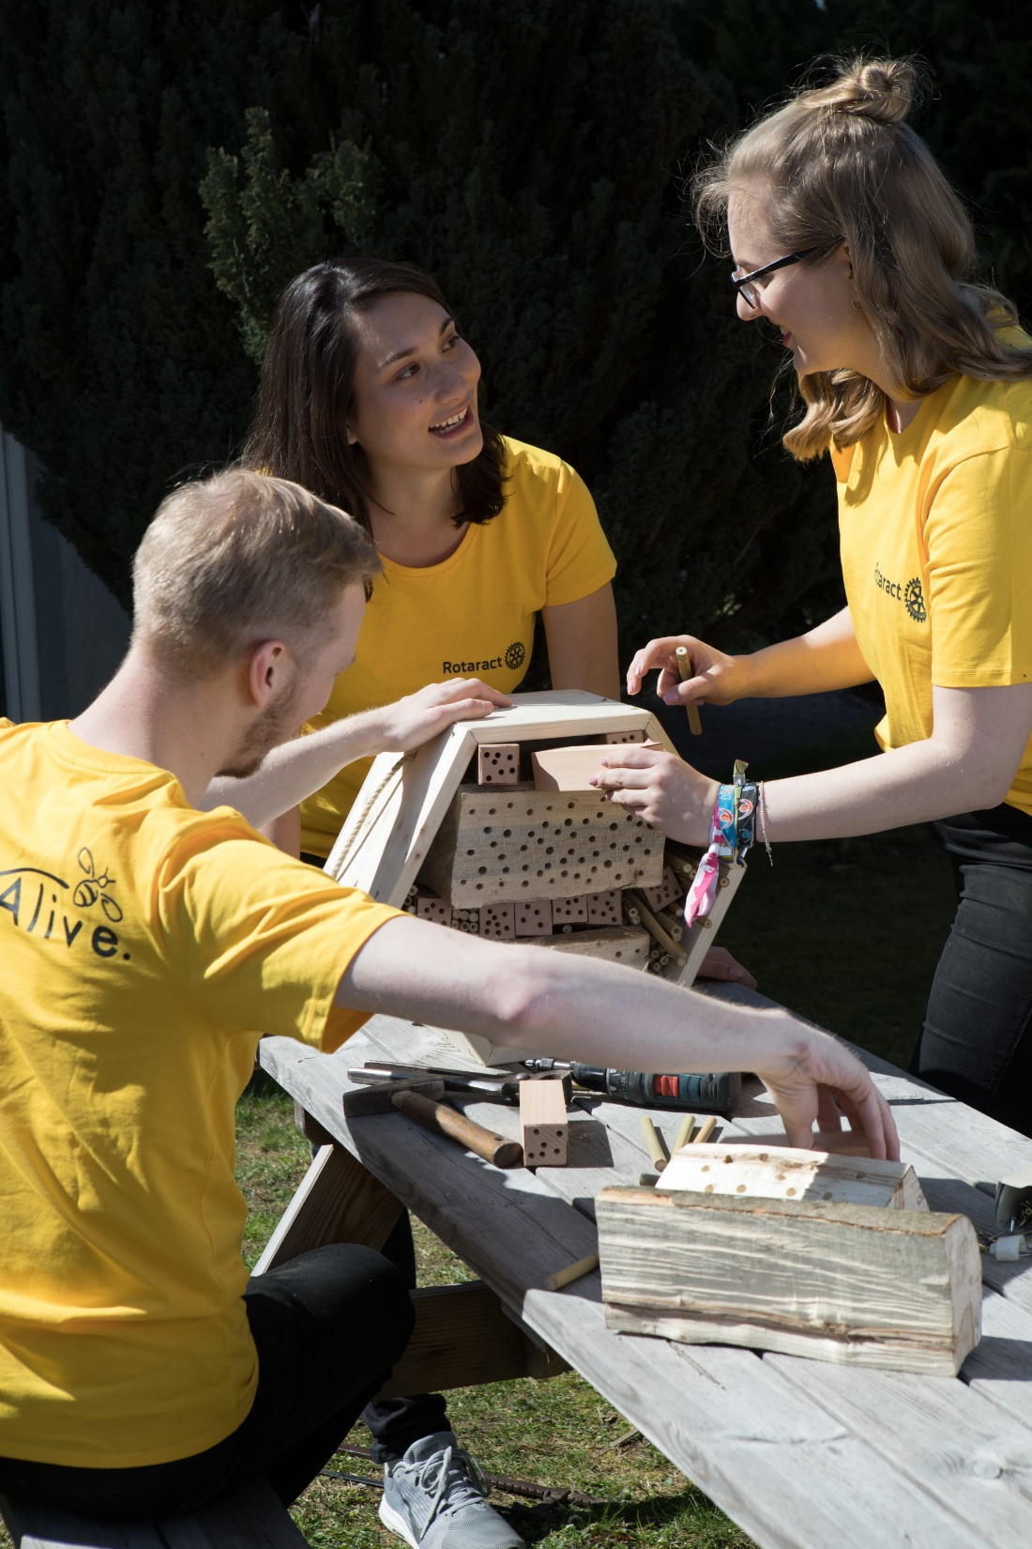
subhead
Build lifelong friendships
Being part of a fellowship is a fun way to make friends around the world, explore a hobby or profession, and enhance your Rotary experience.
ROTARY.ORG/FELLOWSHIPS
Notes:
Rotary Fellowships consist are designed for those who share a common interest in recreational activities, sports, hobbies, or professions. These groups help expand skills, foster vocational development, and enhance the Rotary experience by exploring interests while developing connections around the world.

Slide 8

subhead
Learn new skills
Learn everywhere and anytime with Rotary’s Learning Center:
Toastmasters Courses, designed for Rotary
Public Image
Mentoring
Leading Change
ROTARY.ORG/LEARN
Notes:
And finally, anyone can take advantage of a wealth of training materials designed to help you learn new skills and become more successful in what you do. Take courses, find resources, connect with an online community, talk with other registrants and course moderators, customize your user profile, and track your progress. Sign in with your My Rotary account at rotary.org/learn, or find the link on My Rotary under the Learning & Reference tab.

Slide 9
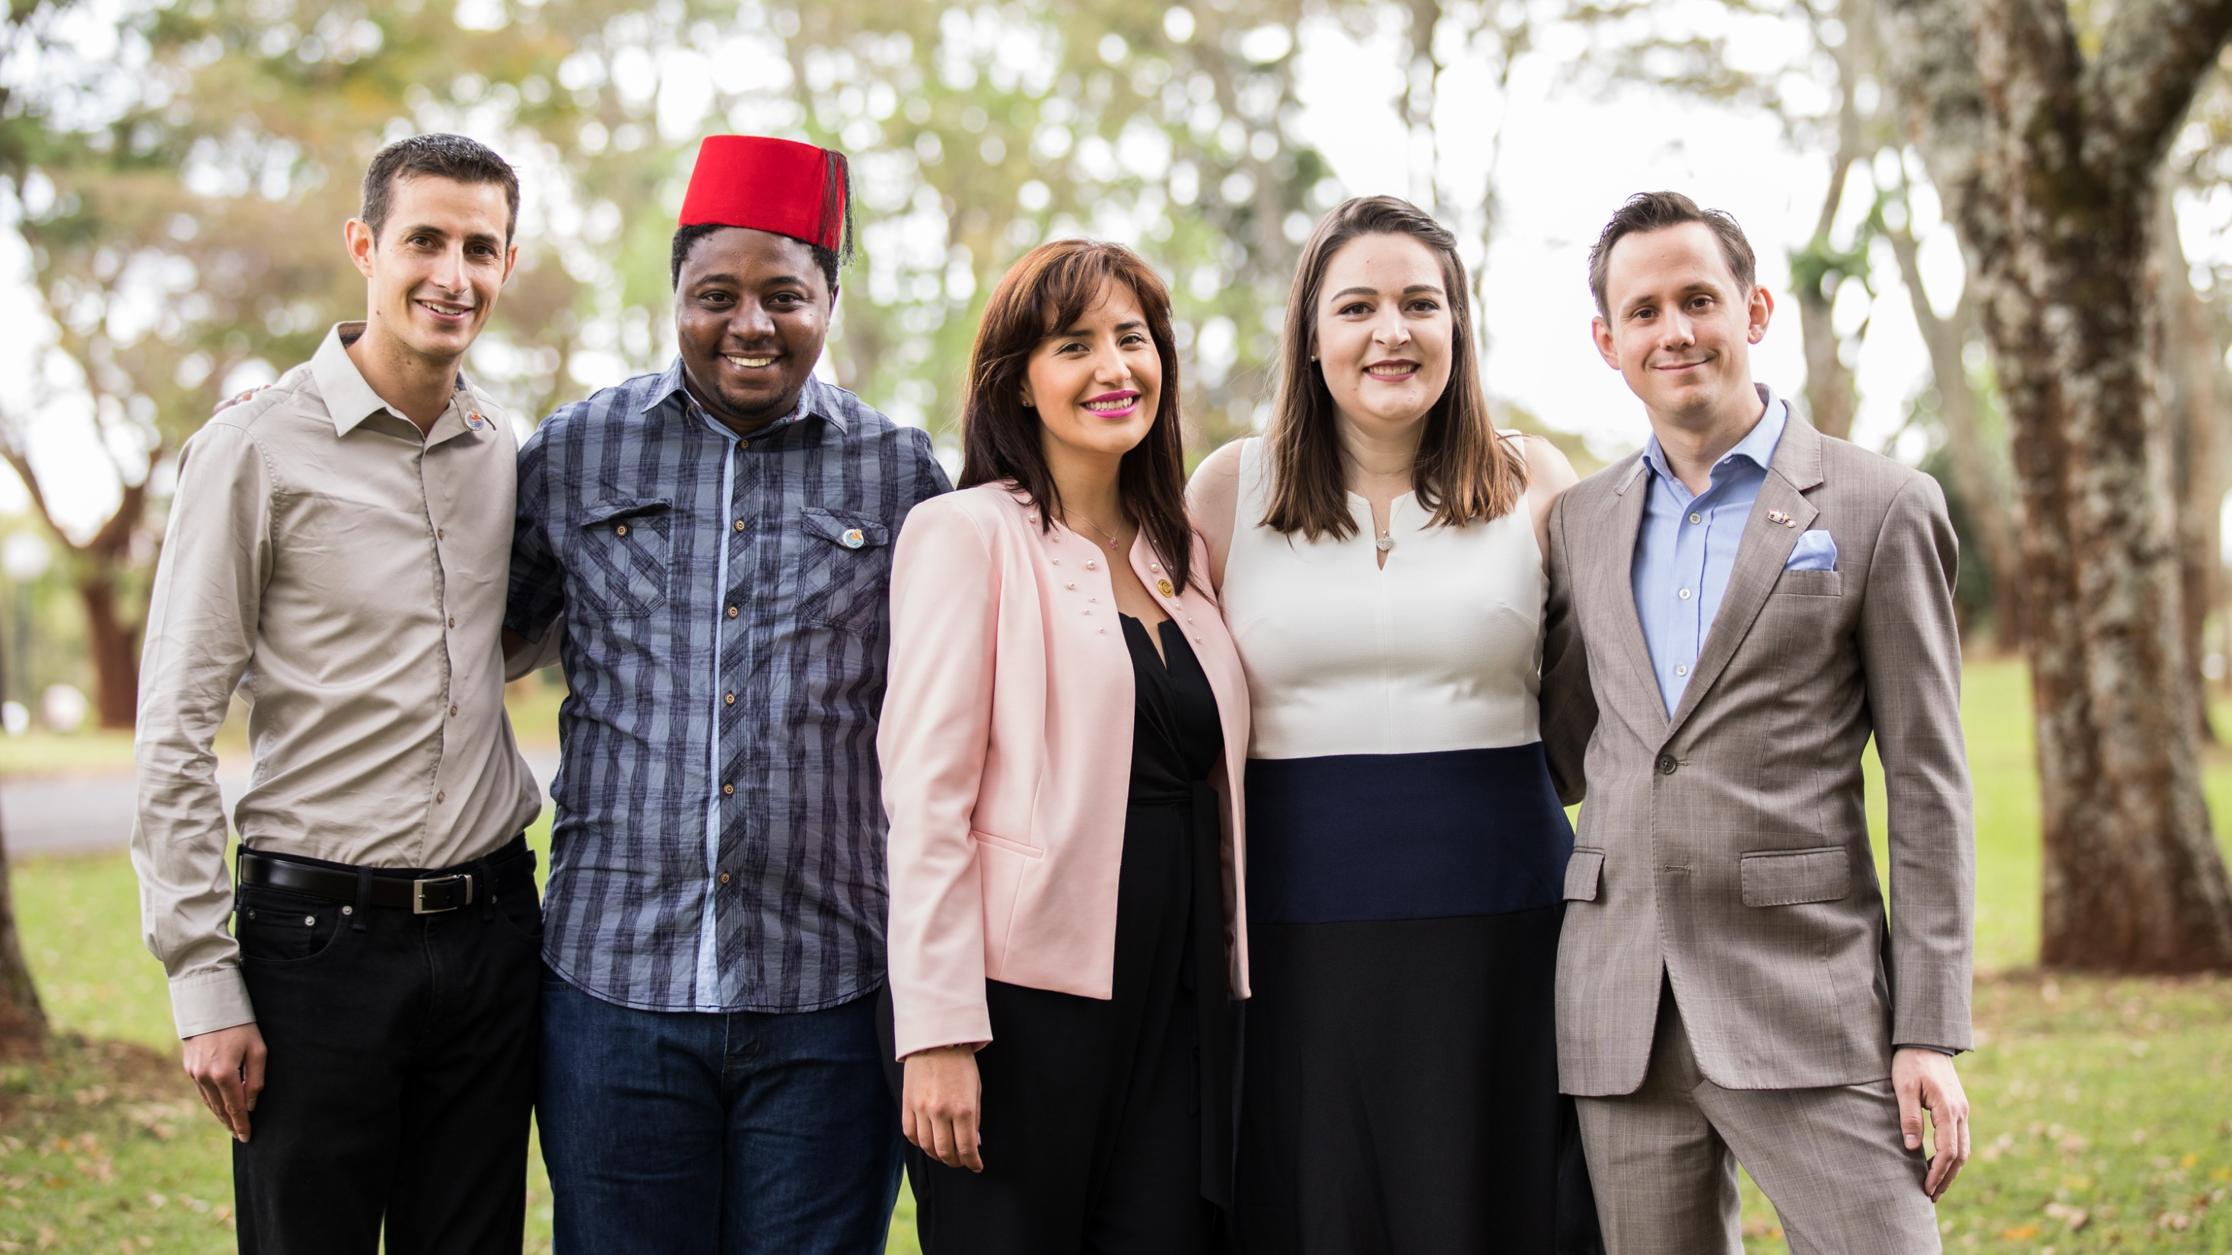
Interested?
Rotary.org/join
Contact us: [INSERT CLUB LOGO]
[INSERT CLUB NAME AND CONTACT INFORMATION
Notes:
You don't have to be a Rotary member to get involved with Rotary. Connect with a local Rotary club near you to find out what's available and how you can be involved.
Are there any questions I can answer?

Slide 10
QUESTIONS

